Slide 1
ALM and profit
The Danish experience
IMF Roundtable, November 15th 2007
Washington DC
Ib Hansen
Danmarks Nationalbank

Slide 2
Issues
Gov. debt and reserves ALM
  Currency risk
  Interest rate risk
Communicating result

Slide 3
ALM
Gov. debt and reserves
Government borrows FX to supplement the FX-reserves – not to finance deficit
Objective
  Avoid borrowing in one currency and investing in another currency
Net currency exposure is interesting
  1992-2000 Managing net currency exposure on a daily basis
  2001 -> All borrowing in euro

Slide 4
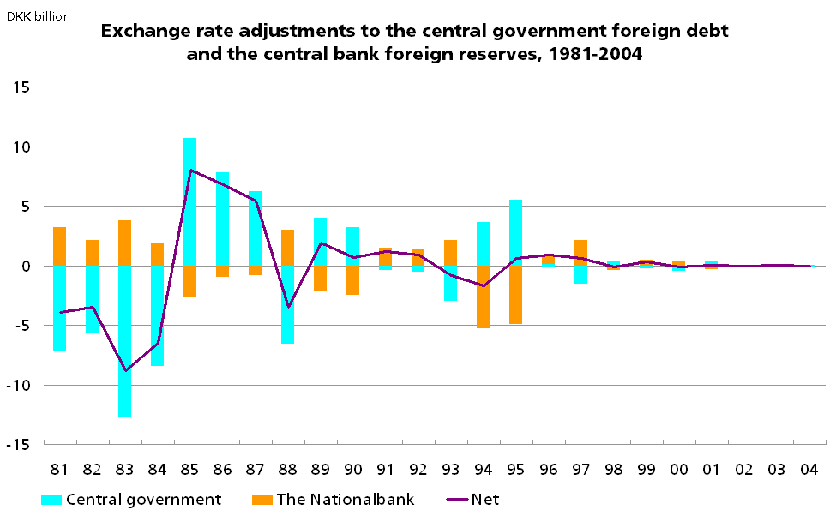
Before and after coordination….
No coordination
Coordination
EURO

Slide 5
Several ways to take government into account
Norway
NB assets match liability vs. government
  Immunisation reserves.
  Used to offset government foreign debt.
  Petroleum fund.
  Used to transfer risk to government
Denmark
Indirect
Same currency mix for investing and borrowing
  All borrowing in Euro
  All in/out flow of reserves in euro.

Slide 6
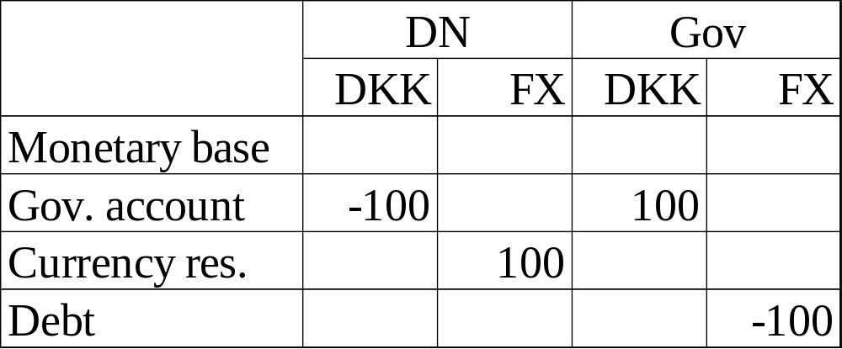
Interest rate
Linkage between reserves and gov. FX borrowing
If duration of currrency reserves and government debt is equal
The interest risk is mached.

Slide 7
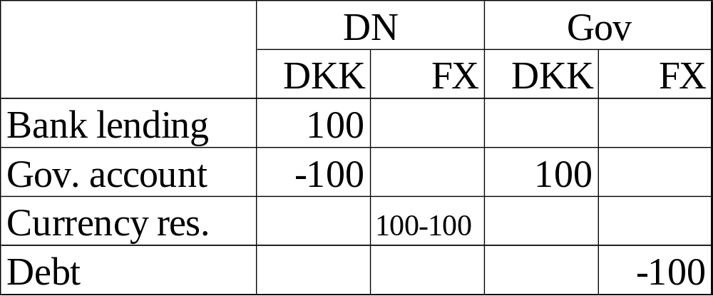
After intervention
Bank lending has duration of 0.
In order to maintain unchanged interest rate risk before
and after intervention duration of debt and currency reserve should
be zero.

Slide 8
Interest rate ALM
On the margin ALM between Danmarks Nationalbank and government.
However each institution decides its level of interest rate risk according to its objectives.
When deciding the level of CB risk, the whole balance sheet is considered.
When deciding the level of gov. risk only gov. debt and financial assets is considered. Ie not taxes and expenditures.

Slide 9
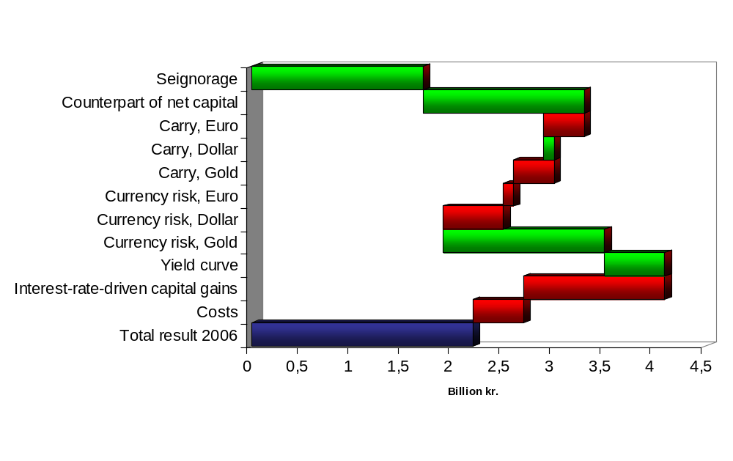
Lego Bricks (including costs)

Slide 10
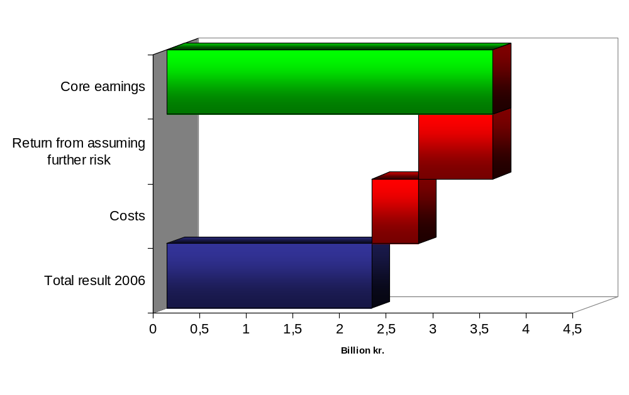
Policy- and return driven return

Slide 11
Accounting matter
All mark-to-market gain/loss hit the P/L
Realized and unrealized gains/loss:
  Are treated equally in the accounts
  Are not transferred to the government
  But transferred to a value adjustment reserve.
➔ Economic exposure =
Accounting exposure

Slide 12
SO
Benefits from looking at currency risk of both assets and liabilities are huge
  But challenges on the institunal side
Difficult to mt ake total interest rate risk management
  But possibilities of integrating on the margin
Clearly explaining the drivers behind the P/L of the central bank makes communication easier

